Slide 1

How does optimal photosynthetic acclimation affect future carbon and nutrient cycling?
Nick Smith¹, Trevor Keenan^{2,3}, Qing Zhu³, & Bill Riley³
¹Texas Tech University
²University of California Berkeley
³Lawrence Berkeley National Laboratory

Slide 2
Photosynthesis connects carbon and nutrient cycles
nick.smith@ttu.edu; @nick_greg_smith
Walker et al. (2020)

Slide 3
Photosynthesis connects carbon and nutrient cycles
nick.smith@ttu.edu; @nick_greg_smith
Walker et al. (2020)

Slide 4
A typical LSM photosynthesis scheme
nick.smith@ttu.edu; @nick_greg_smith
Climate
Soil N
Leaf N
Photosynthesis

Slide 5
nick.smith@ttu.edu; @nick_greg_smith
Photosynthesis tends to scale with leaf N
Kattge et al. (2009)

Slide 6
Nutrients thus provide constraints on future productivity
nick.smith@ttu.edu; @nick_greg_smith
“No limitation” simulation
“Nutrient limitation” simulations
Weider et al. (2015)

Slide 7
That is, if leaves cannot get needed nutrients, future CO₂ fertilization of photosynthesis may be constrained

Slide 8
Some evidence suggests photosynthetic downregulation is partly determined by photosynthesis
nick.smith@ttu.edu; @nick_greg_smith
mean: -15%
Smith and Keenan (2020)

Slide 9
There is another explanation for this effect: photosynthetic optimality
nick.smith@ttu.edu; @nick_greg_smith
(P > 0.05)
Smith and Keenan (2020)

Slide 10
Biochemistry optimization: Coordination hypothesis
nick.smith@ttu.edu; @nick_greg_smith
Optimal setup = equal limitation by all factors

Slide 11
Optimally: electron transport-limited (A_{j}) = Rubisco-limited (A_{c})
nick.smith@ttu.edu; @nick_greg_smith
A_{j} = A_{c}
A_{j} = f{light, T, CO₂}
A_{c} = f{V_{cmax}, T, CO₂}
Smith et al. (2019)

Slide 12
nick.smith@ttu.edu; @nick_greg_smith
V_{cmax} = f {light, T, CO₂}
Smith et al. (2019)

Slide 13
A typical LSM photosynthesis scheme
nick.smith@ttu.edu; @nick_greg_smith
Climate
Soil N
Leaf N
Photosynthesis

Slide 14
Least cost optimality model
nick.smith@ttu.edu; @nick_greg_smith
Climate
Leaf N
Photosynthesis

Slide 15
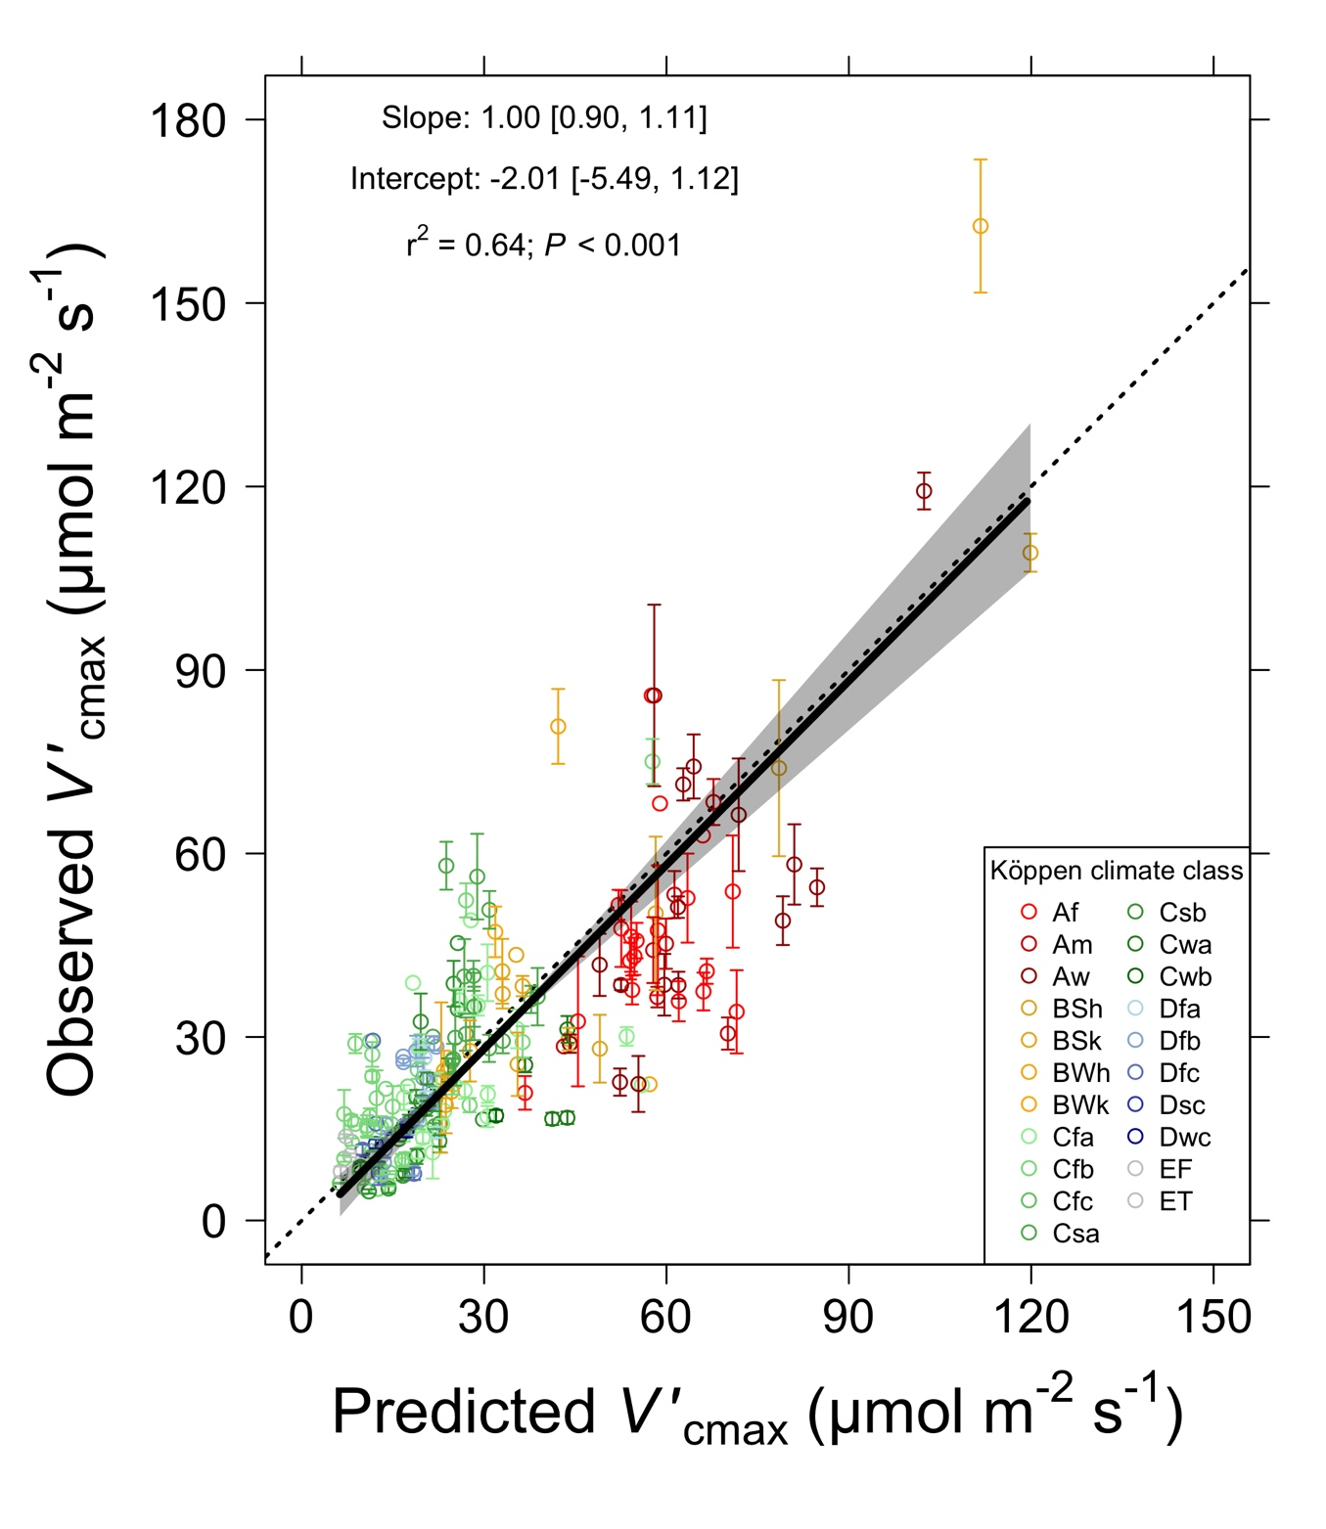
nick.smith@ttu.edu; @nick_greg_smith
Optimal V_{cmax} is similar to observed values
Smith et al. (2019)

Slide 16
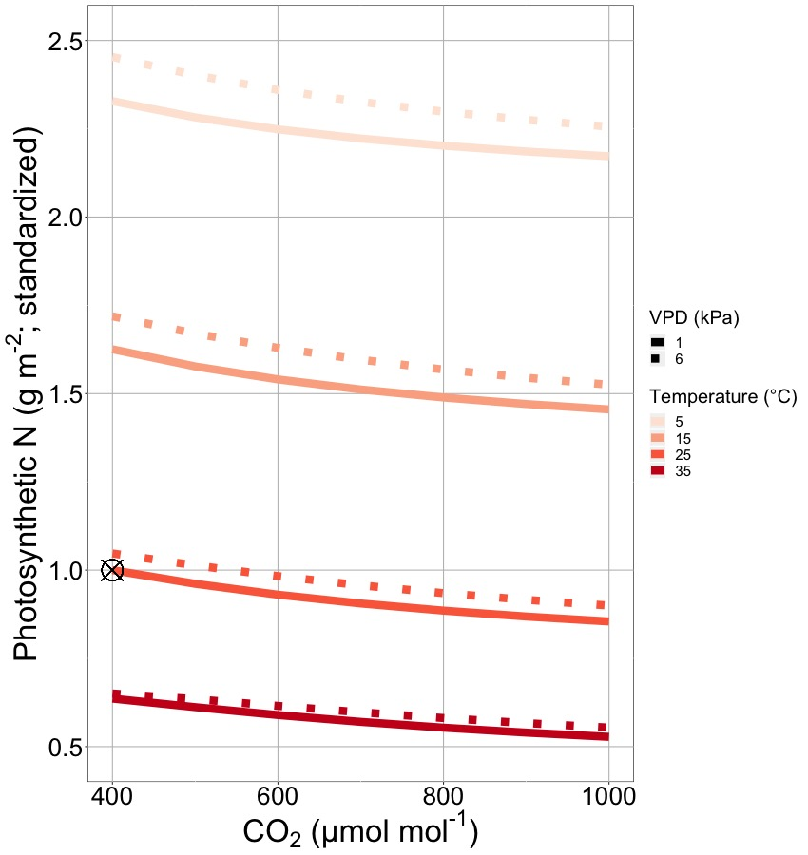
Optimality suggests that leaf nitrogen will decrease with warming and elevated CO₂
nick.smith@ttu.edu; @nick_greg_smith
Smith and Keenan (2020)

Slide 17

Let’s run a model out into the future!
nick.smith@ttu.edu; @nick_greg_smith
Qing Zhu (LBNL)

Slide 18
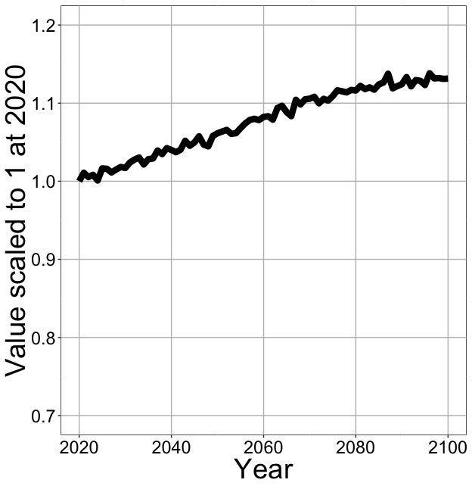
Optimal photosynthesis increases in future
nick.smith@ttu.edu; @nick_greg_smith
Net Photosynthesis
Smith et al. (in prep)

Slide 19
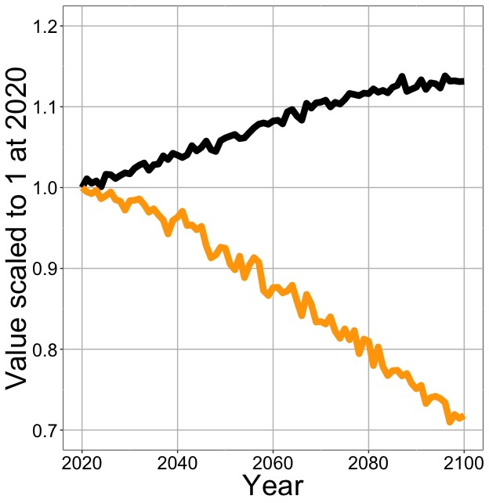
Optimal photosynthesis increases in future (at lower nutrient use)
nick.smith@ttu.edu; @nick_greg_smith
Net Photosynthesis
Leaf Nitrogen
Smith et al. (in prep)

Slide 20
Optimal photosynthesis increases in future (at lower nutrient use)
nick.smith@ttu.edu; @nick_greg_smith
Net Photosynthesis
Base ELM shows <5% change in leaf N
Leaf Nitrogen
Smith et al. (in prep)

Slide 21
Why does this matter?

Slide 22
Future progressive nutrient limitation may be overestimated
nick.smith@ttu.edu; @nick_greg_smith
“No limitation” simulation
“Nutrient limitation” simulations
Weider et al. (2015)

Slide 23
Future progressive nutrient limitation may be overestimated
Future elevated temperature and CO₂ should decrease leaf nutrient demand
Smith and Keenan (2020)

Slide 24
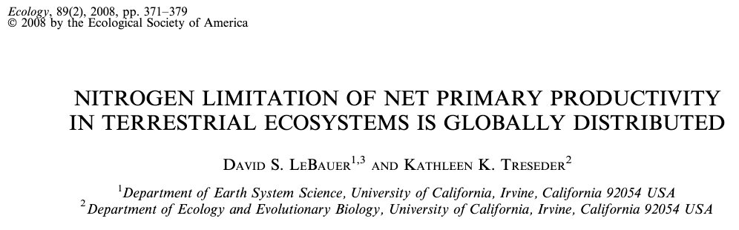
Future progressive nutrient limitation may be overestimated
Future elevated temperature and CO₂ should decrease leaf nutrient demand
“Extra” nutrients could be used to build new tissues

Slide 25
Future progressive nutrient limitation may be overestimated
Future elevated temperature and CO₂ should decrease leaf nutrient demand
“Extra” nutrients could be used to build new tissues
This may reduce the magnitude of PNL
“No limitation” simulation
“Nutrient limitation” simulations
Weider et al. (2015)

Slide 26
Let’s check this with a model!
nick.smith@ttu.edu; @nick_greg_smith
Qing Zhu (LBNL)

Slide 27
ELM biogeochemistry runs
Optimal photosynthetic coordination determines leaf nutrient demand
Using available nutrients, plants try to meet this demand
If demand cannot be met, leaves are purged
If demand is met, any excess nutrients are used to build new tissue using ELM’s optimal allocation scheme
Allocation, but not photosynthetic nutrient demand, varies by PFT
Simulations done with and without calculated nutrient savings

Slide 28
Nutrient savings does not impact leaf photosynthesis

Slide 29
Nutrient savings is used to build new tissues, increasing NPP

Slide 30
Conclusions
Photosynthetic N demand is reduced under future elevated CO₂ and temperature
Least cost optimality theory can predict this
The theory can (and should) be incorporated into ESMs
Progressive nitrogen limitation will likely not be as strong as current models predict

Slide 31

nick.smith@ttu.edu; @nick_greg_smith
Presentation available at:
www.github.com/SmithEcophysLab/seminar/agu_2020
Thanks!

